Slide 1
Angular: Importance of Angular
BY:D.SRIHITHA
22H51A0512
CSE-D

Slide 2

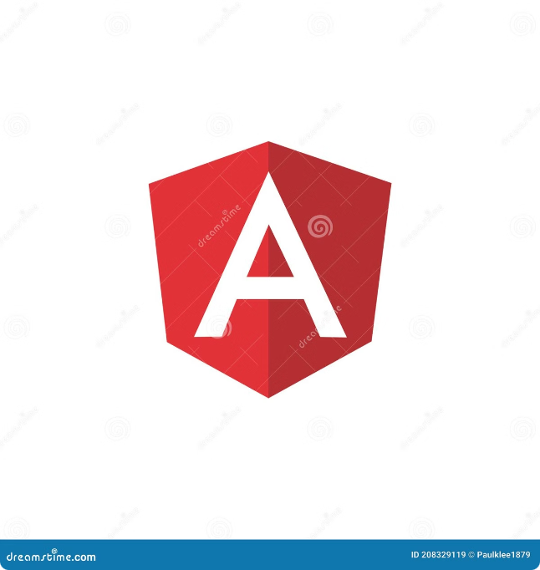
What is Angular?
Angular is a powerful JavaScript framework developed and maintained by Google. It enables developers to build dynamic, single-page applications (SPAs) with a focus on efficiency and scalability.

Slide 3


Importance of Angular
Scalability
Performance
Angular's modular structure allows for the creation of complex applications that can grow and adapt to evolving needs.
Angular optimizes for speed, ensuring a smooth and responsive user experience, even with large amounts of data.
Maintainability
The framework's consistent architecture promotes code reusability, making it easier to maintain and update projects over time.

Slide 4


Key features of Angular
1
Component-based architecture
2
Dependency injection
This powerful mechanism allows components to request dependencies they need, promoting code modularity and testability.
Angular emphasizes breaking down applications into smaller, reusable components, making development more manageable and organized.
3
Template syntax and data binding
4
Routing and navigation
Angular provides a built-in routing system that simplifies navigation between different views in a multi-page application.
Angular uses a clean and expressive template syntax to define the structure and behavior of components, enabling efficient data binding.

Slide 5
Angular's component-based architecture
Components
Templates
Modules
Angular applications consist of reusable components that encapsulate their own logic, templates, and styles, promoting modularity and code reuse.
HTML templates define the structure and presentation of components, incorporating data binding and directives to provide dynamic content.
Angular applications are organized into modules, which provide a logical grouping of related components, services, and directives.

Slide 6

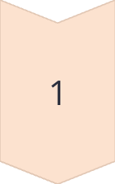
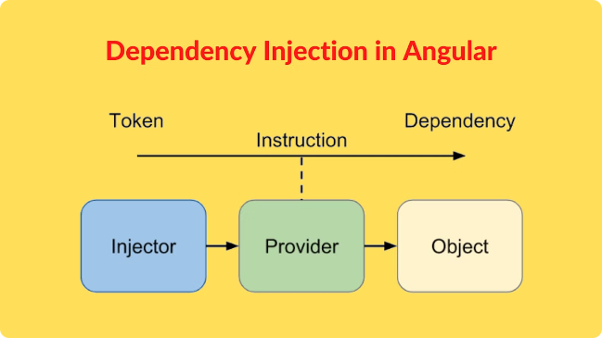
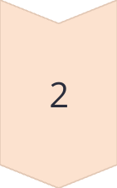
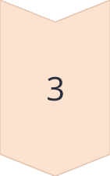
Angular's dependency injection system
Dependency Request
Components request the services they need, without having to know how those services are created.
Dependency Provider
The Angular framework manages the creation and provision of services, ensuring they are available when needed.
Dependency Injection
The framework injects the requested dependencies into the component, enabling it to perform its tasks.

Slide 7

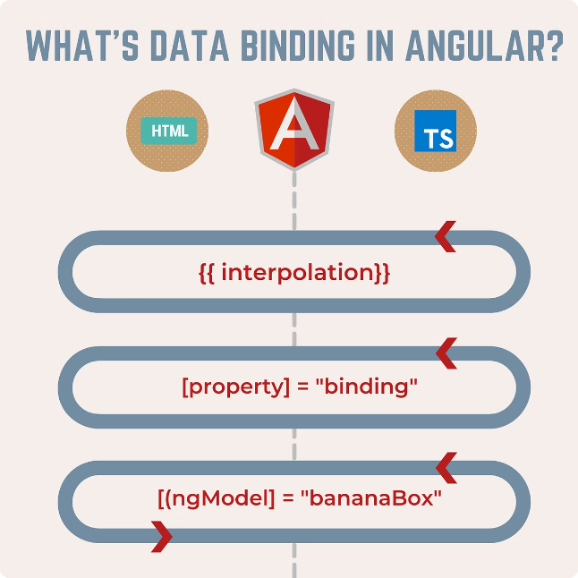
Angular's template syntax and data binding
Double Curly Braces {{ }}
Interpolates data values into the template.
Square Brackets []
Used for directives, which modify the behavior or appearance of elements in the template.
Parentheses ()
Trigger events and methods, allowing user interactions to trigger actions in the component.

Slide 8

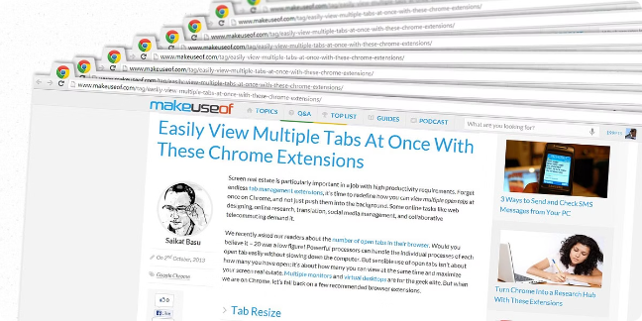
Angular's routing and navigation
1
Route Configuration
Defines the routes, their associated components, and how they are accessed within the application.
2
Route Matching
When a user navigates to a specific URL, Angular matches the route and loads the corresponding component.
3
Component Rendering
Angular renders the associated component, displaying the appropriate view for the matched route.

Slide 9


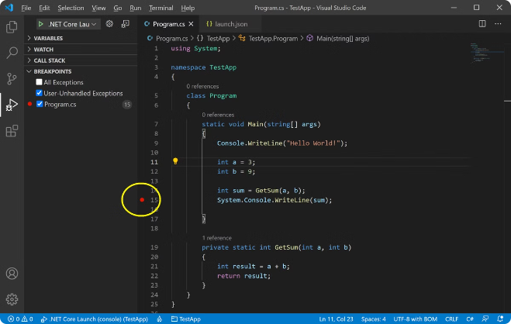


Angular's testing and debugging tools
Unit Testing
Testing individual components and services to ensure they function correctly in isolation.
End-to-End Testing
Testing the entire application flow, simulating user interactions and verifying expected outcomes.
Debugging Tools
Angular provides powerful debugging tools that enable developers to inspect the application state, track data flow, and identify issues.

Slide 10


Advantages of using Angular for web development
1
Scalability
2
Performance
Angular's modular structure and robust features enable the development of complex applications that can grow and adapt.
Angular prioritizes performance, ensuring smooth and responsive user experiences even with large amounts of data.
3
Maintainability
4
Community Support
The framework's consistent architecture promotes code reusability, making it easier to maintain and update projects over time.
Angular benefits from a large and active community, providing resources, support, and a vast collection of libraries and packages.

Slide 11
THANKYOU….

